Slide 1
SAP NetWeaver Gateway
11/02/2011

Slide 2
Agenda
Gateway Overview

Slide 3
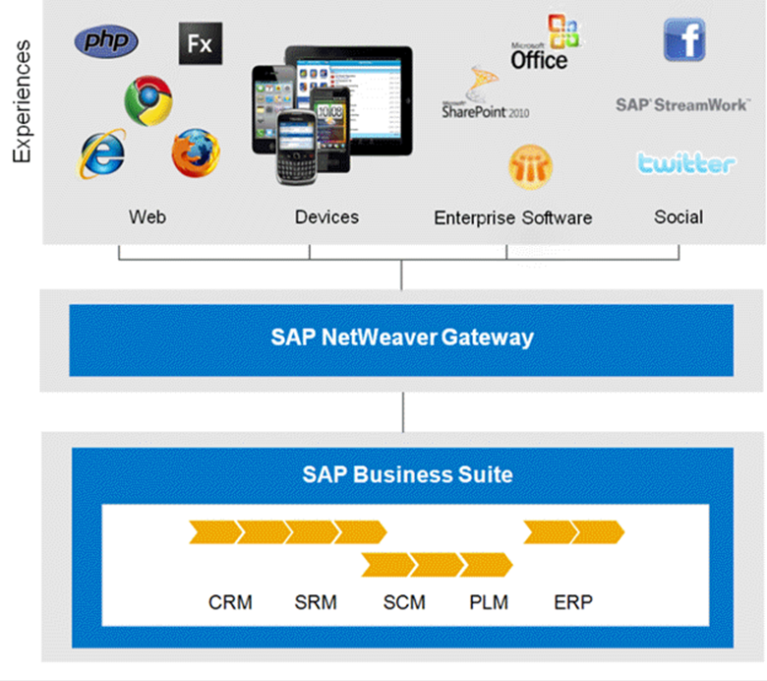
Definition:
SAP Netweaver Gateway is a development framework which is available as a SAP Netweaver Application Server ABAP (AS ABAP) add-on, which you can install on top of your existing SAP Business Suite or application platform.

Slide 4




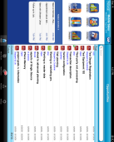










SAP NetWeaver Gateway Overview
Web
Mobile
Enterprise Software
Social
Open Any Environment, Any Platform, Any Experience
People Optimized for user interaction scenarios
Timeless Non-disruptive, any SAP Business Suite version
Developers Simple APIs, no SAP knowledge required
Standards Based on REST and OData/ATOM
Experiences
Sybase Unwired
Platform
SAP NetWeaver Gateway
SAP Business Suite
CRM
SRM
SCM
PLM
ERP

Slide 5
SAP NetWeaver Gateway Architecture
IDEs
Consumer
Consumer
Consumer
Network Standards
Plug-ins
Tools
Gateway Core Technology
OData with SAP Annotations
Supportability
Generators
BOR/SCR/
RFC
Custom
Dev.
REST
Metadata Repository
Monitoring
SAP NetWeaver
Service Adaptation
Events
Security
SAP NetWeaver Gateway
Data Source Providers
Data Conn.
BAPI
RFC
WS
SAP Business Suite [ERP,CRM,SRM…]

Slide 6
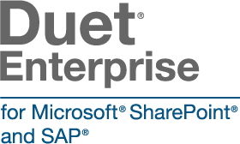







SAP NetWeaver Gateway & Sybase Unwired Platform
Web, Office, …
Mobile Device
Apps
Container
Libraries
OData Protocol
MBO
Relay Server
SAP Data Protocol
OData Protocol
MBO
SUP
Content
OData Protocol
stack for Online apps
Gateway
stack for Offline apps
RFC, BAPI, Dynpro
RFC, BAPI
SAP Business Suite
Adapter
API

Slide 7
声明：
所有的版权属于原有公司，文件均来自公开渠道
此文件仅供学习使用，任何人不得进行以此为商业目的的行为
如有疑问，请立即删除
学习世界五百强和咨询公司PPT课程请访问如下网站搜索：“司马懿”
百度传课：司马懿PPT学校
网易学堂：司马懿PPT学校
知乎： 司马懿PPT学校
访问地址
https://www.chuanke.com
访问地址
https://study.163.com
访问地址
https://www.zhiu.com

